Slide 1
Data Analytics PRESENTATION
Predictive Analysis of Equipment Failure

Slide 2
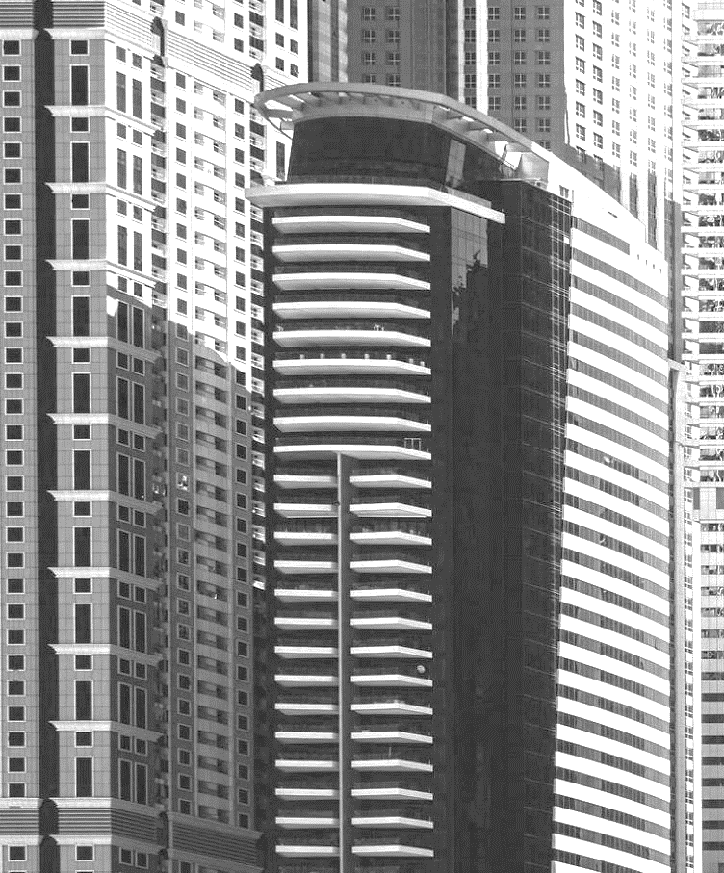

AGENDA
INTRODUCTION
Problem Statement
Requirements
Explaining The Dataset

Slide 3

INTRO
The dataset contains all the data starting from the Identity of the Consumer to the Installation and Running of equipment on the source.
Data is collected from the Manufacturer and from the Installation department.

Slide 4
Problem Statement
We are clear on our view that we want to make a model that is capable of detecting the failure of an equipment way before the actual failure.
The dataset that we have has been taken from the industry itself and has all the actual features that is needed to satisfy our goal.
We will be targeting Solar Panel for our project and at the end our model will be capable of informing failure of any panel prior to its actual failure.

Slide 5
Requirements
There can by many requirements for such model to exist but we are targeting the most important and impacting ones and we have concise the requirements for better and clear understating.
Model bought
Specification of Model
Operating Power
Operating Requirements
Presentation Title
5

Slide 6
The dataset has 43 attributes ranging from the buyer details to the time of buying and the model specification. It was not possible to mention all the 43 attributes so we have categorized them and mentioned them here.
(Data Attributes mentioned here are prior preprocessing)
Buyer Identity -> String -> Nominal
Installation Place -> String -> Nominal
Region -> String -> Nominal
Model Specification -> String -> Nominal, Binary
Model Specification -> Integer
Presentation Title
6

Slide 7
Preprocessing
The Dataset should be clean of empty cells and noise and must be consistent.
All the categorical data should be encoded before going for regression,
Feature Scaling has also to be done to make all the quantitative data are maintaining a range.

Slide 8
Dealing with empty and unnecessary cells
All the unnecessary columns were dropped and the empty cells were filled with a updated ideology of mode.
The empty cells were filled with one of the random of the three most repetitive values.
The outliners were pointed with the help of box plot and were replaced by the mean of the column.

Slide 9
Visualization
Graphs

Slide 10
Model Building

Slide 12
THANK YOU

